Slide 1
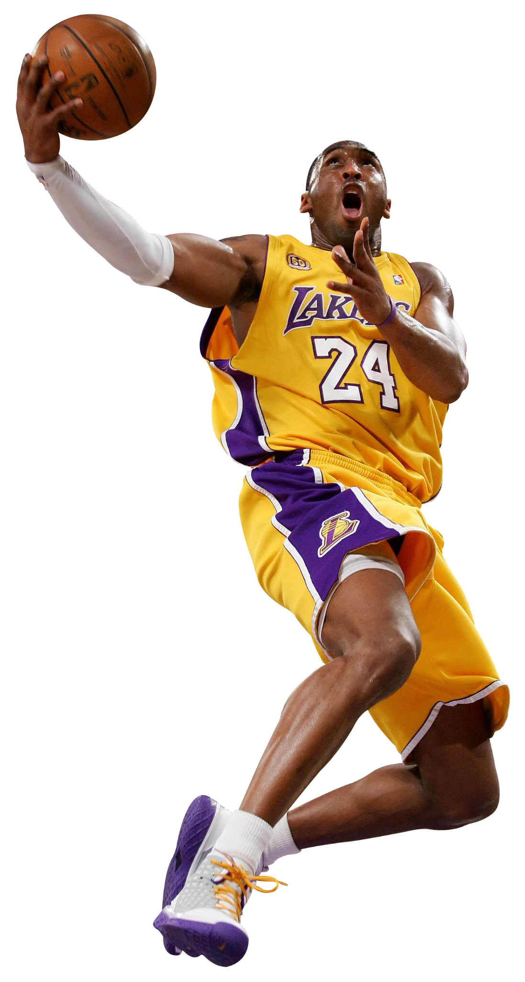
THE
KOBE BRYANT
SHOT

Slide 2


DATASET
The data set analyzed herein provides the location and specific situation / circumstances associated with every field goal attempted by Kobe Bryant, over his 20-year LA Lakers career.
https://www.kaggle.com/c/kobe-bryant-shot-selection/data
Notes:
1996 NBA draft straight out of HS
2nd youngest ever to be drafted at the time; As a rookie, won the Slam Dunk Contest,
5x NBA champion
2008 and 2012 Summer Olympics, he won two gold medals as a member of the U.S. national team
18 All-Star designations are the second most all time
Only guard in NBA history to play for a single franchise 20+ years

Slide 3
SMART QUESTIONS
Do specific game situations affect accuracy?
Does the spatial location of shots affect accuracy?
Do his shots indicate the hot hand effect?

Slide 4
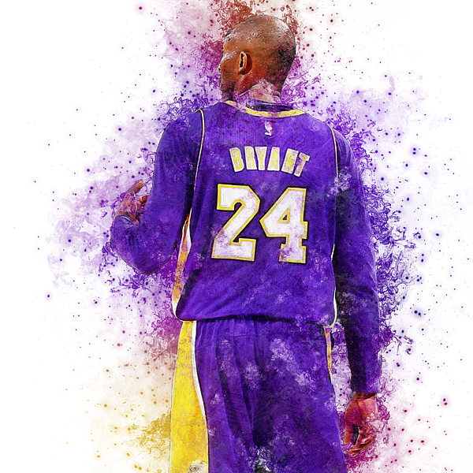
EXPLORATORY
DATA ANALYSIS

Slide 5
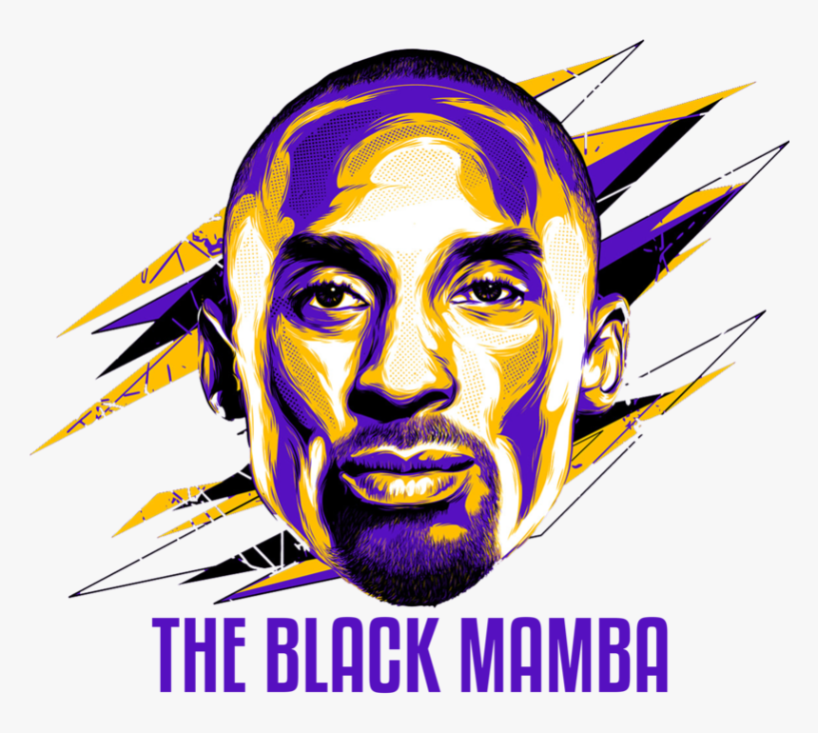
SITUATIONAL SPLITS
Periods
Overtime
Clutch-Time
Playoffs
Home / Away
Opponents
Seasons
Championships
Notes:
Next few slides consider FG% and shot distance as primary numerical variables
sliced & diced across qualitative or categorical situational splits
Shot distance - convenient and logical initial numerical variable of interest
Later will be extrapolated upon utilizing precise spatial location data
Career FG% serves as a baseline or proxy for modeling purposes (discussed later in prez)

Slide 6
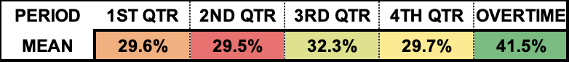
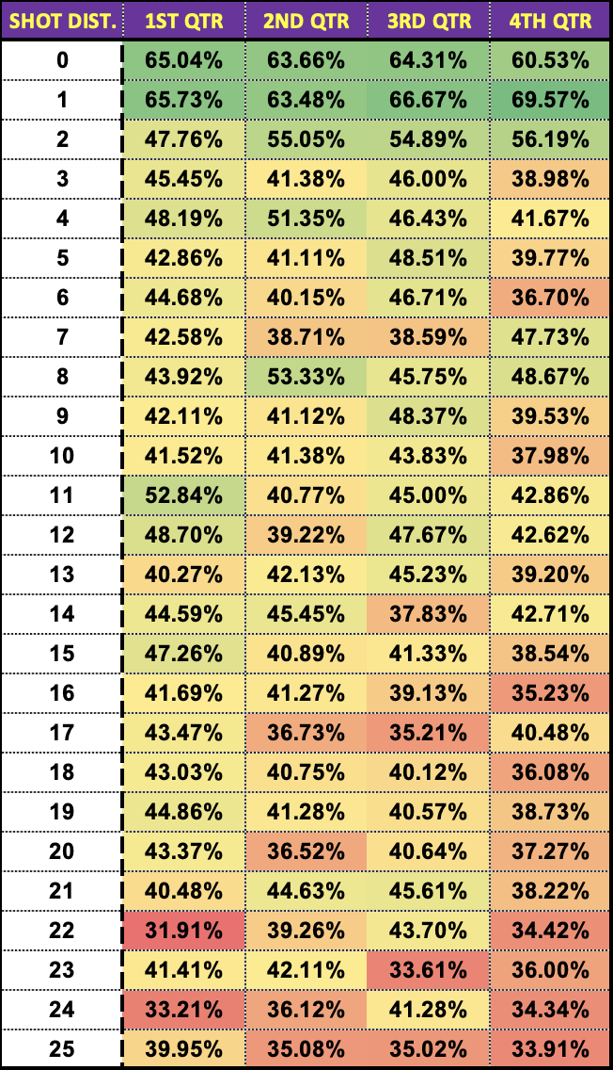
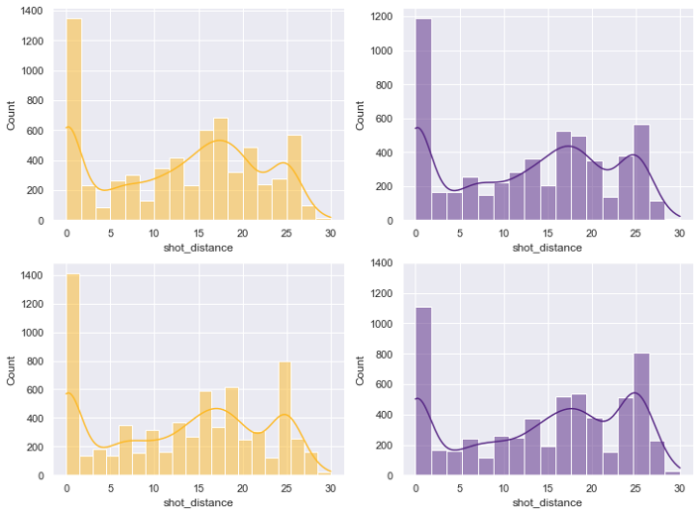
PERIOD SPLITS
1st QTR
2nd QTR
3rd QTR
4th QTR
Notes:
Similar distribution across quarters; not a normal distribution due to extreme volume of close-range shots
Increased volume at start of game and right after halftime (third quarter)
Deeper shot distance in the second half (third/fourth quarter)

Slide 7
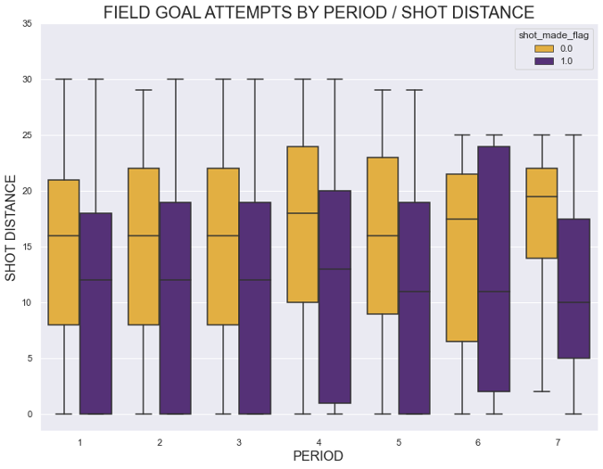
OVERTIME SPLITS
Notes:
Less shots data for overtime periods than traditional quarters; less impactful to analyze independently

Slide 8
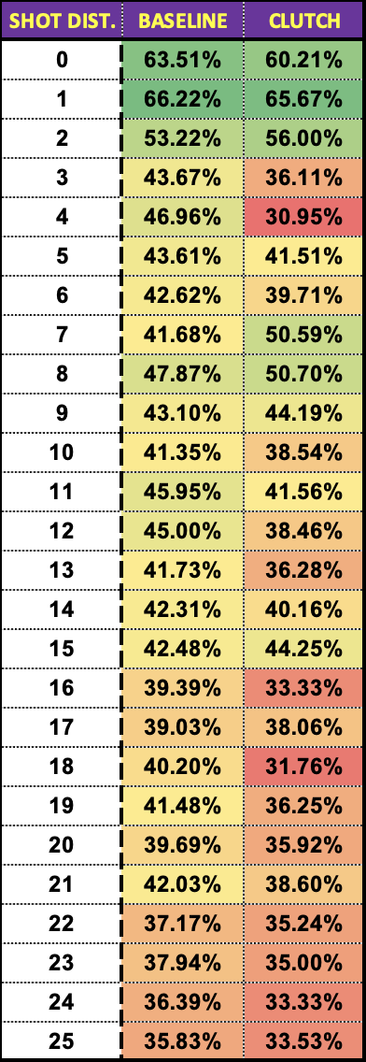
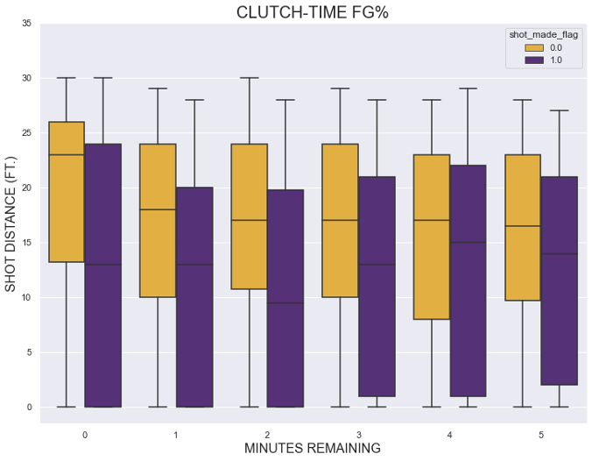
CLUTCH-TIME
4th Qtr. (<= 5 Min.)
Overtime (<= 5 Min.)
‘Clutch-Time’ is often referenced as a measure of player performance across critical possessions / closing min.
Notes:
Band of ‘Shots made’ in purple expands as the game reaches its final minutes
Kobe has a license to chuck at will; increased volume
As game winds down, Kobe attacks the paint at a higher rate while still getting up shots from deep
Mixed bag in terms of shot-making accuracy / FG%

Slide 9
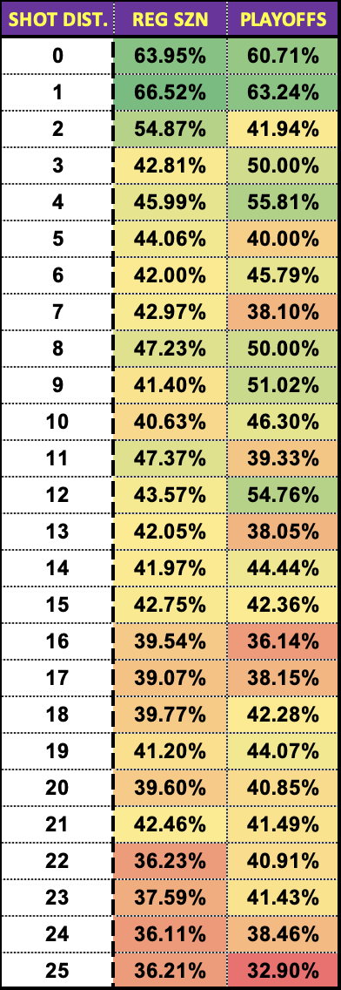
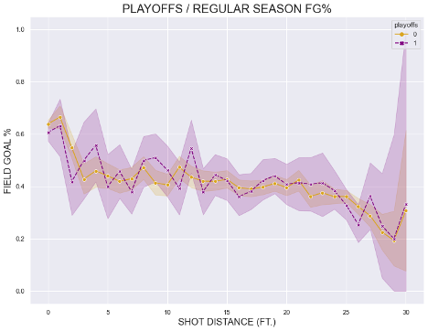
PLAYOFF SPLITS
Notes:
Somewhat inconclusive - increased shot volume throughout the playoffs perhaps the cause of excess volatility in FG% during the playoffs
PLAYOFFS - 41.0%
REG SEASON - 41.9%

Slide 10
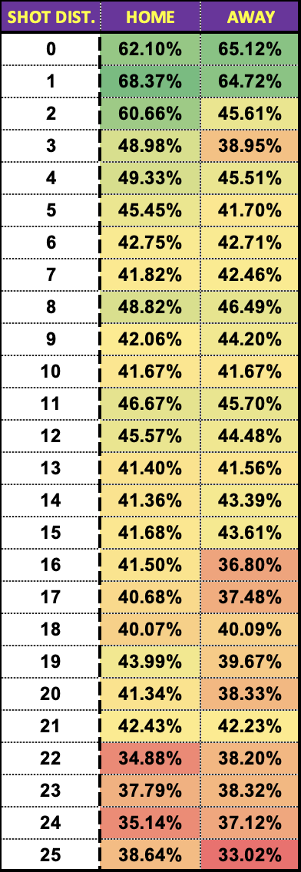
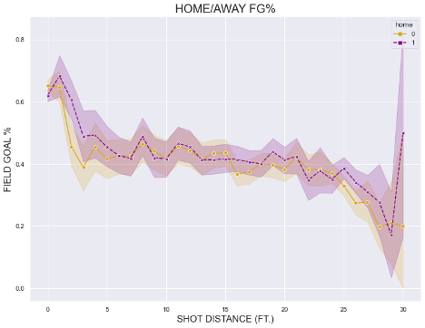
HOME / AWAY SPLITS
Notes:
Kobe definitely produced at a higher level - clearly better shooting splits - playing at home in Staples Center (now Crpyto.com Arena)
HOME - 42.8%
AWAY - 39.8%

Slide 11
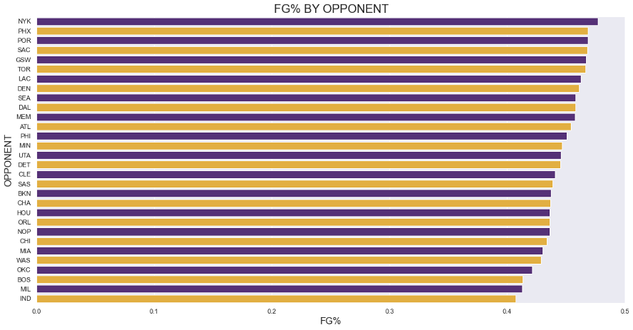
OPPONENT SPLITS
Notes:
Knicks - Kobe loooves playing at MSG
LA Clippers - share same stadium; home or away game?
4 of top 5 are west coast teams - more frequent matchups, knows their strengths and weaknesses better
Seattle - now OKC Thunder; wide margin between the two

Slide 12
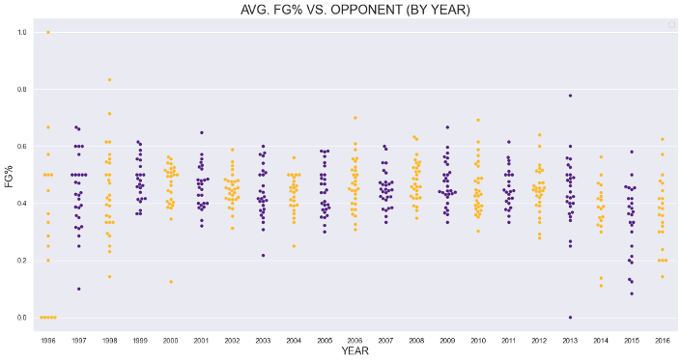

SEASON SPLITS - FG% VS. OPPONENT
Notes:
Team-by-team FG% over time
Rookie / youth struggles
End of career tailspin (achilles injury, poor teammates)

Slide 13
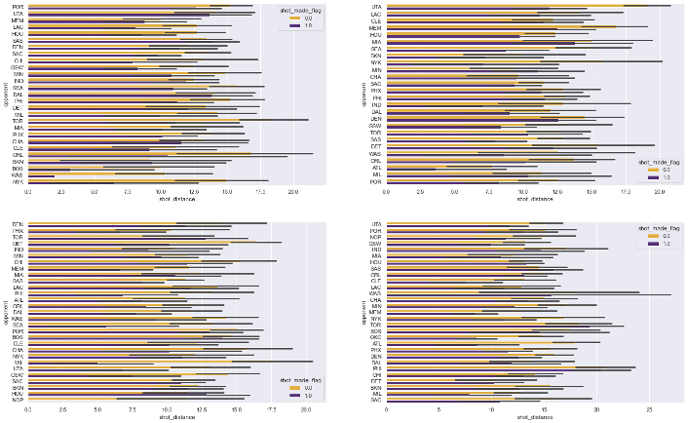
CHAMPIONSHIP RUNS (2000, 2001, 2002, 2009)
2000
2001
2002
2009
Notes:
Significantly more shots from deep during 2009 championship season
Kobe’s game evolving on its own, or a response to evolving trends in gameplay across the NBA (three pointers)?
Shaq as teammate for first three championships - only one ball !
Although we are not attempting to predict wins, it would be interesting to layer in the team’s Win/Loss success rate on top of Kobe’s shooting performances

Slide 14
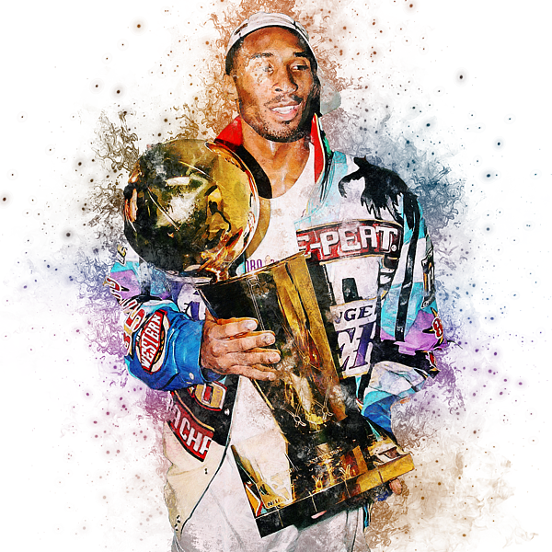
Does the spatial location of shots affect accuracy?
We will investigate effect of shot zone, shot zone area and shot zone range on accuracy

Slide 15

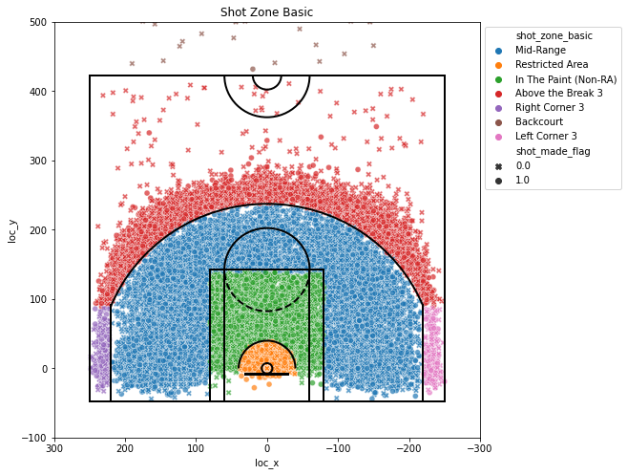
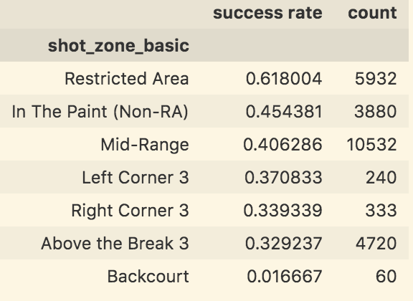
Basic Shot Zone
Highest accuracy in the rectangle
Higher accuracy at left corner than right
Most tries in mid-range

Slide 16

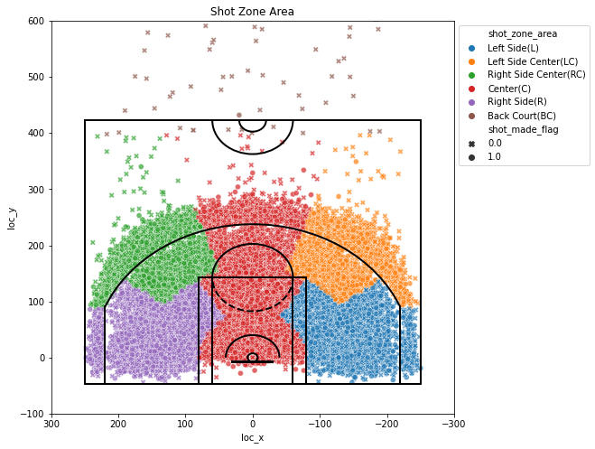
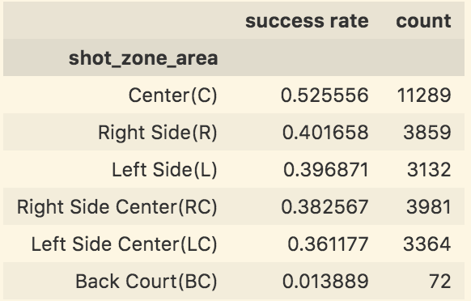
Shot Zone Area
Higher accuracy in areas perpendicular to the rectangle area within certain range

Slide 17
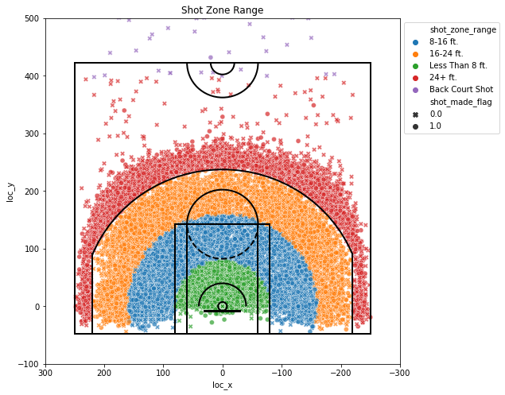
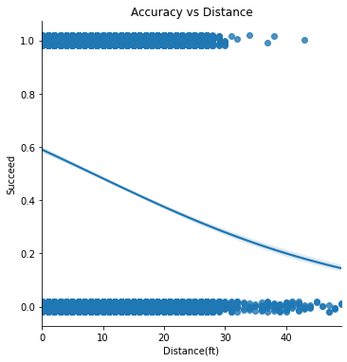
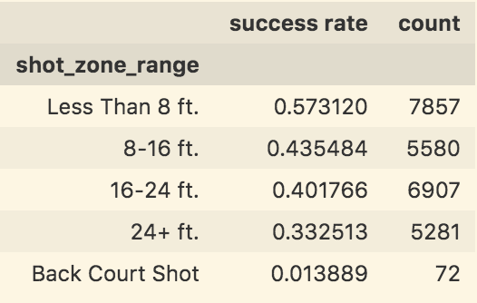
Shot Range and Distance

Slide 18
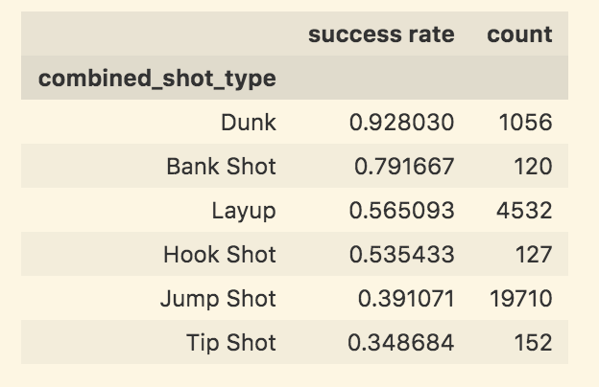
Shot Types
We will investigate effect of shot area with different shot types on accuracy

Slide 19
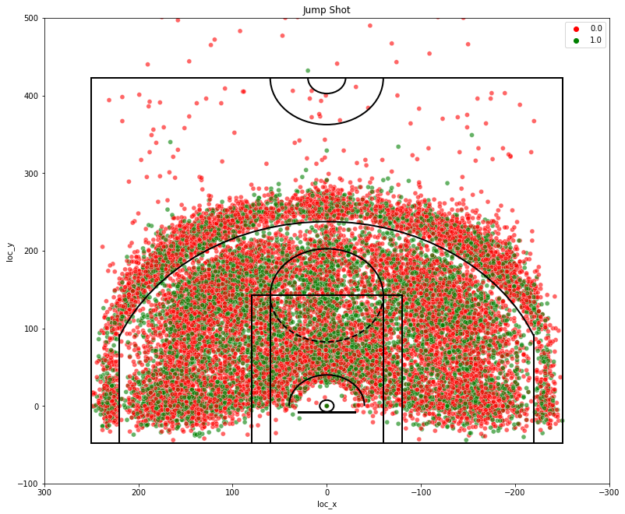
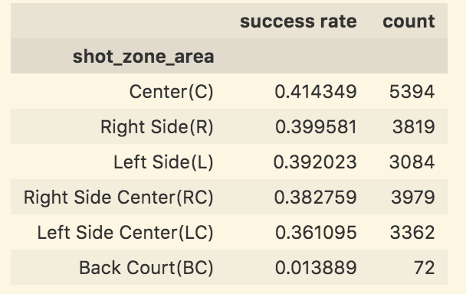
Jump Shot Attempts
Highest frequency
Not significantly affected by spatial areas

Slide 20
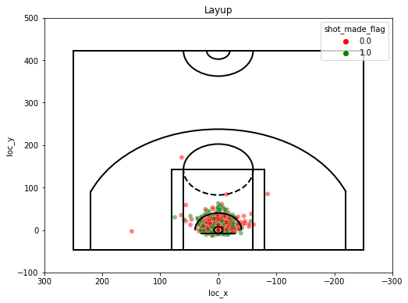
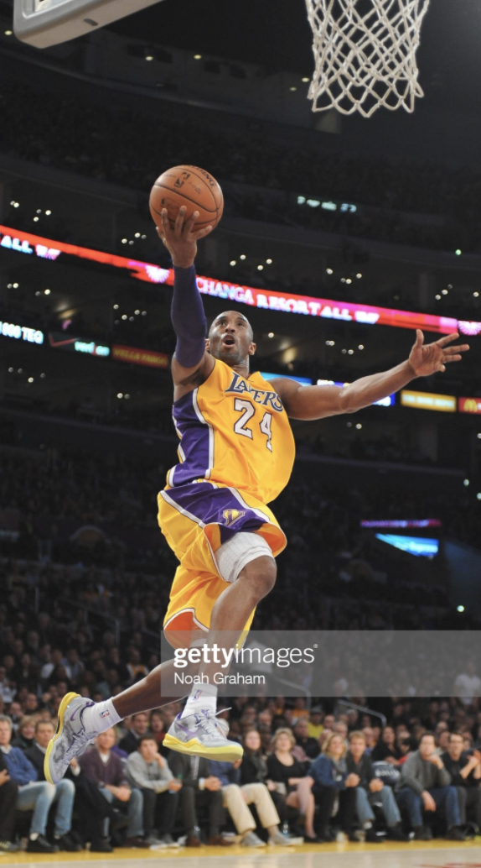
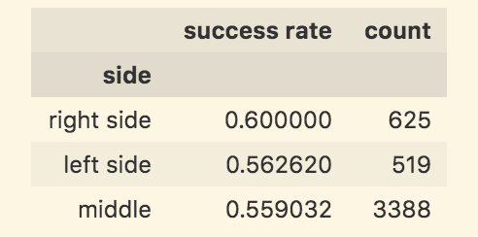
Layup Attempts
What is a layup shot?
Shot near the basket
Lay the ball off the backboard into the hoop
T test between right and left side with p-value=0.20

Slide 21
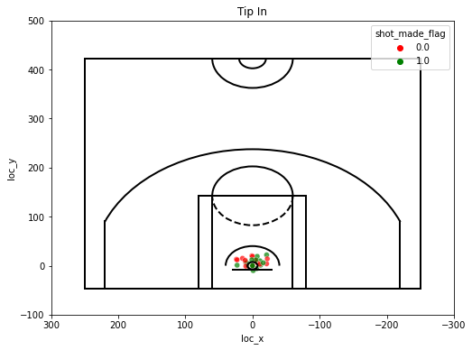
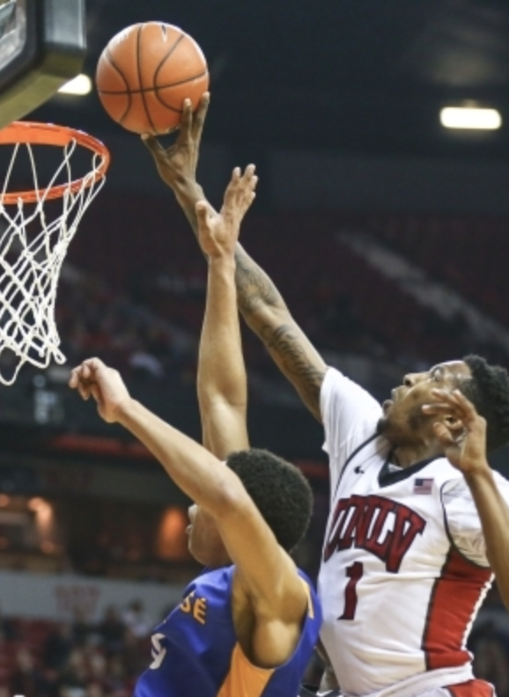
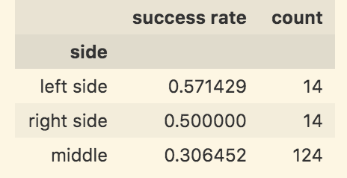
Tip-in Attempts
What is a tip-in in basketball?
Player taps the ball into the hoop
Following a missed shot
T test between right and left side with p-value=0.72

Slide 22
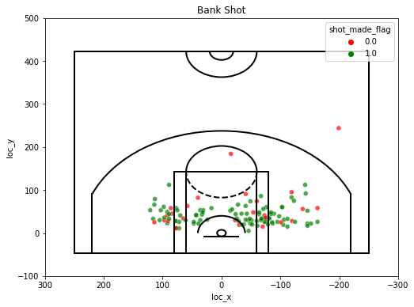
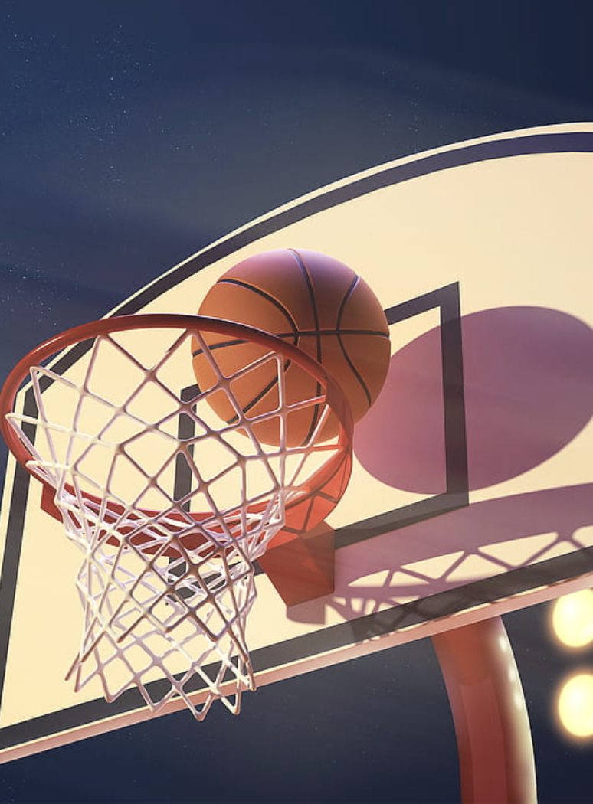
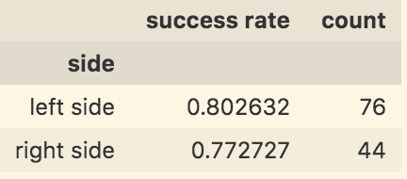
Bank Shot Attempts
What is a bank shot?
Any shot made where the ball hits the backboard before heading into the net
T test between right and left side with p-value=0.70

Slide 23
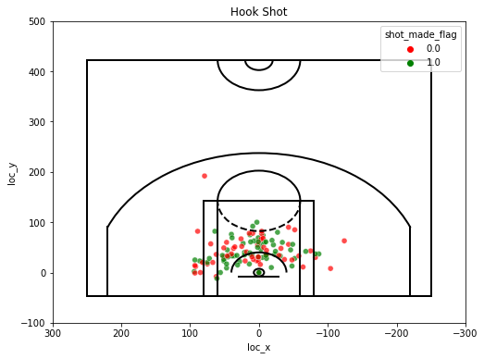
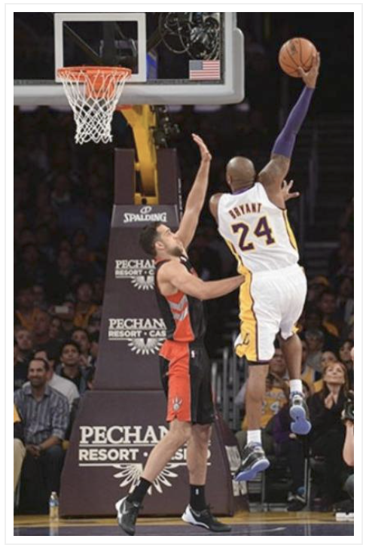
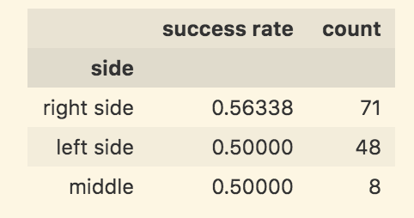
Hook Shot Attempts
What is a hook shot?
Standing sideways to the basket
Swinging the ball up in an arc with the far hand
T test between right and left side with p-value=0.50

Slide 24
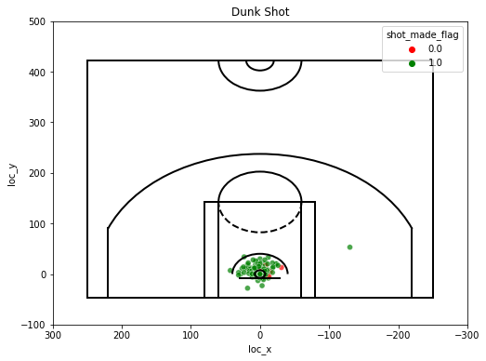
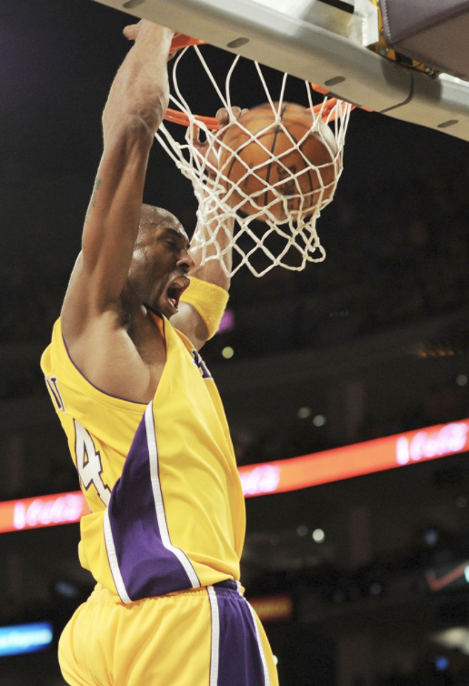
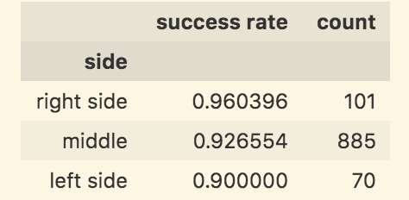
Dunk Shot Attempts
What is a dunk shot?
Slam dunk
Jumping high into the air
Throwing the ball down through the basket
F test among right middle and left side with p-value=0.30

Slide 25
Conclusion
The closer Kobe is to the basket, the more accurate he is.
Kobe is most accurate when he shoots from the center area.
It is very likely to score when Kobe attempts a dunk shot.

Slide 26
Do his shots indicate the hot hand effect?
Hot handedness is a cognitive social bias that a person who experiences a successful outcome has a greater chance of success in further attempts
Higher chance of scoring having scored with the previous shot

Slide 27
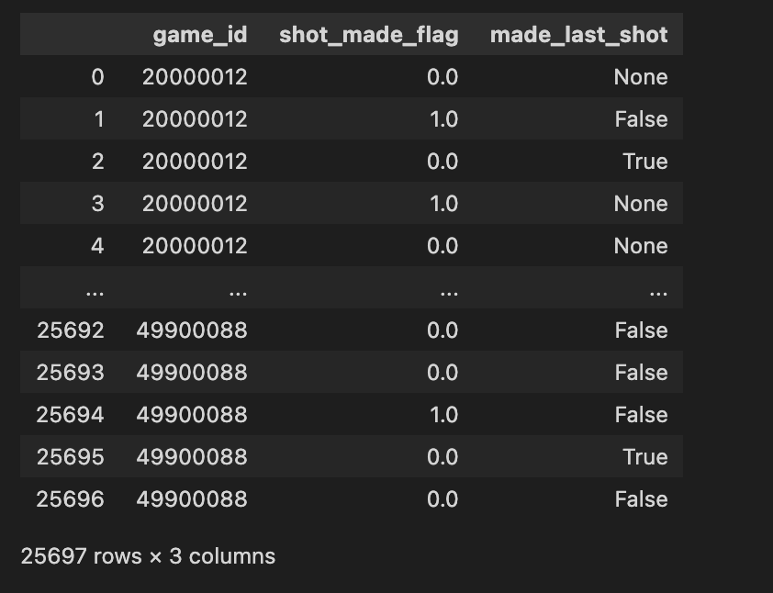
Do his shots indicate the hot hand effect?

Slide 28
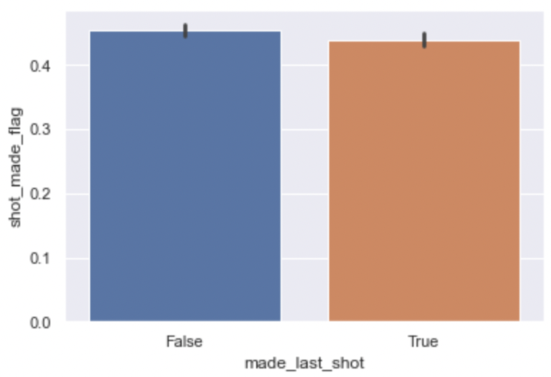
Do his shots indicate the hot hand effect?
T test between both results in a p value of 0.04
If anything, scoring results in overconfidence for Kobe

Slide 29
MODELING
Let’s try to predict shot success

Slide 30
Overview
Train test split was 4:1
Unshuffled to prevent leakage
Do not want to train on data that occurred after a given shot
One hot encoding for all categorical variables
Feature selection using SelectKBest
Scoring function was f_classif

Slide 31
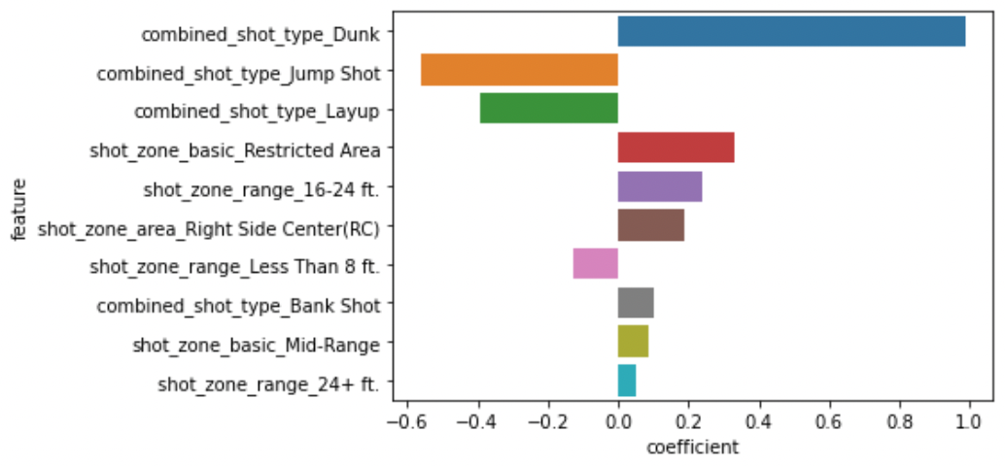
Logistic Regression
2353 | 471
1530 | 786
0
True Label
1
Accuracy 0.61
Precision 0.62
Recall 0.34
0
1
Predicted Label
Feature Importance

Slide 32
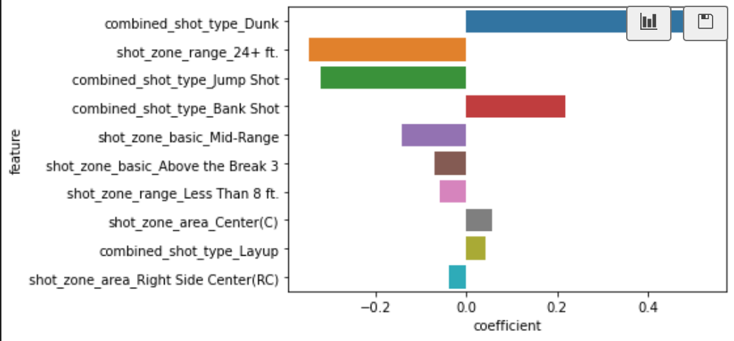
Linear SVM
2424 | 400
1836 | 480
0
True Label
1
Accuracy 0.56
Precision 0.54
Recall 0.20
0
1
Predicted Label
Feature Importance

Slide 33
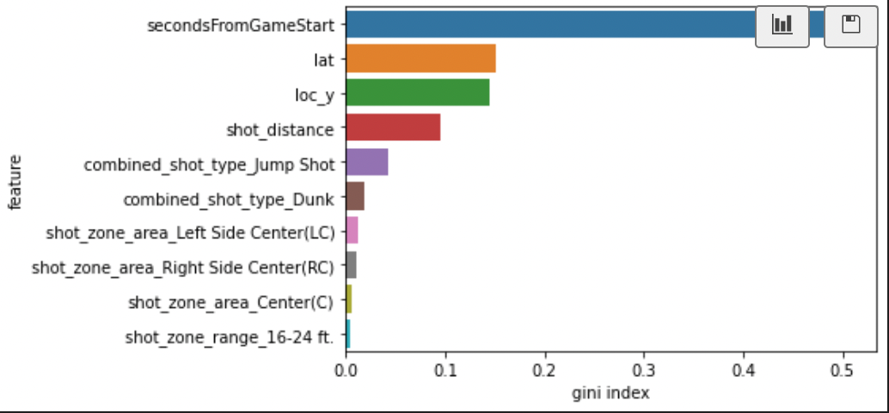
Decision Tree
1679 | 1145
1231 | 1085
0
True Label
1
Accuracy 0.54
Precision 0.49
Recall 0.47
0
1
Predicted Label
Feature Importance

Slide 34
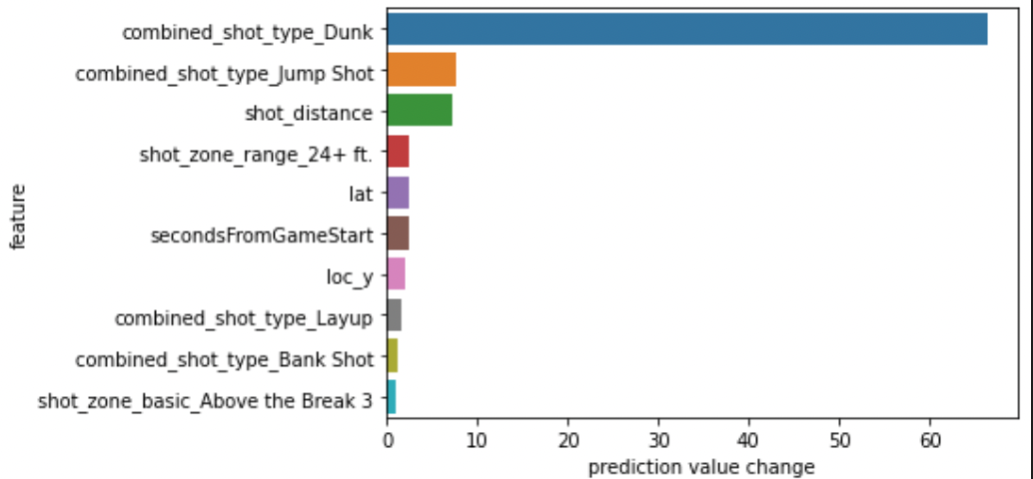
Catboost
2654 | 482
1693 | 868
0
True Label
1
Accuracy 0.61
Precision 0.63
Recall 0.33
0
1
Predicted Label
Feature Importance

Slide 35
Interpretation
Difficult to predict a shot’s success
Feature importances back up what we concluded in our EDA
Shot distance, shot type and area are important features
Helps us answer our spatial location smart question

Slide 36
THANKS!
Any questions?

Slide 37
REFERENCES / CITATIONS
https://www.kaggle.com/bbx396/kobechart
https://basketballiseasy.wordpress.com/2018/05/17/learn-shots-to-basket-hook-shot-and-jump-shot/
https://www.gettyimages.co.nz/detail/news-photo/kobe-bryant-of-the-los-angeles-lakers-rises-for-a-layup-news-photo/159557335
https://www.reviewjournal.com/sports/unlv/unlv-basketball/derrick-jones-jr-expects-to-play-for-unlv-on-saturday/attachment/unlv-forward-derrick-jones-jr-1-attempts-to-tip-in-a-shot-against-san-jose-state-guard-brandon-clarke-15-during-a-basketball-game-at-the-thomas-mack-center-in-las-vegas-on-wednesday-fe-2/
https://bleacherreport.com/articles/441930-los-angeles-lakers-kobe-bryants-top-10-dunks-for-his-birthday
https://www.basketball-reference.com/

Slide 38
